Slide 1
Getting Started with the Intel Galileo
Bret Stateham
Microsoft Technical Evangelist
bretstateham.com
@BretStateham

Slide 2
Overview
Intro to the Galileo
Setting up your Galileo
Running your first Sketch
Next Steps

Slide 3
Intro to the Intel Galileo

Slide 4
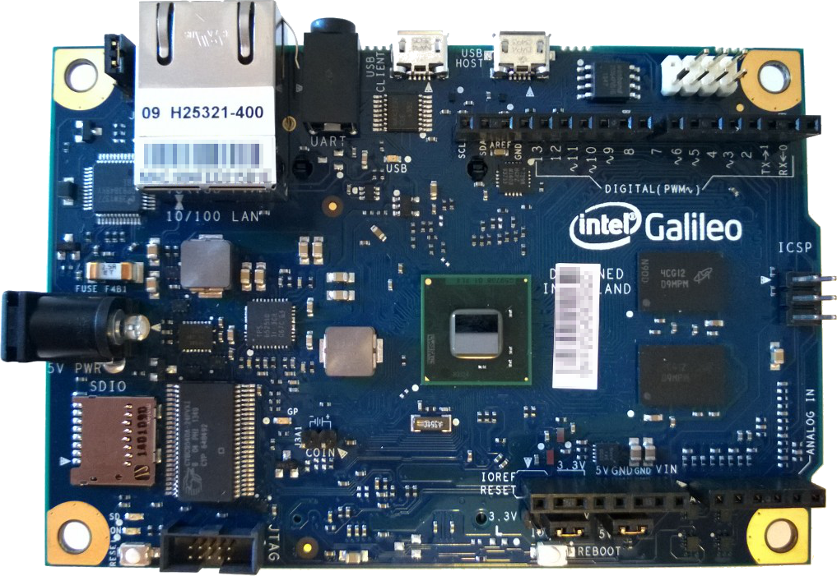
Intel Galileo overview
“Arduino Certified” board
Uses Intel Quark SOC w/ 256MB RAM
Arduino UNO R3 Pin Compatible
Has connections for….
Ethernet
RS232 3.5mm jack
USB Client (connect to pc)
USB Host (connect to peripheral)
Mini PCI Express on the back
Runs Linux by default
Can boot other OSs from SD Card

Slide 5
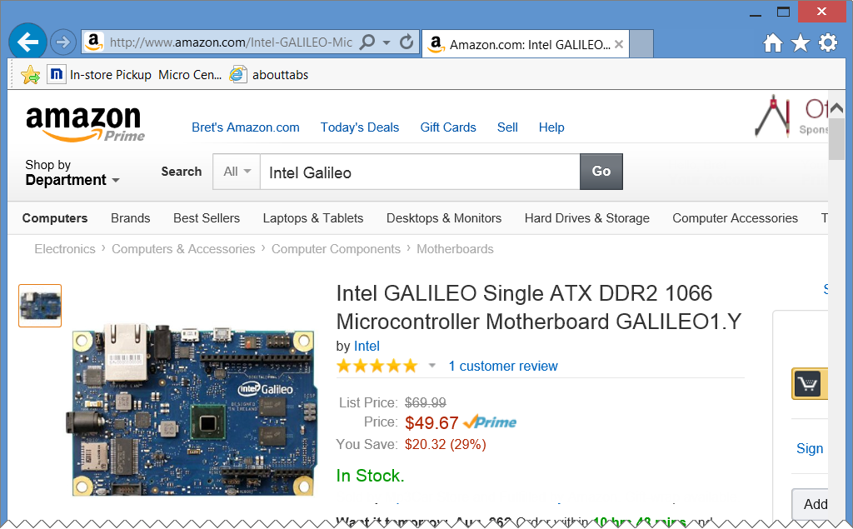
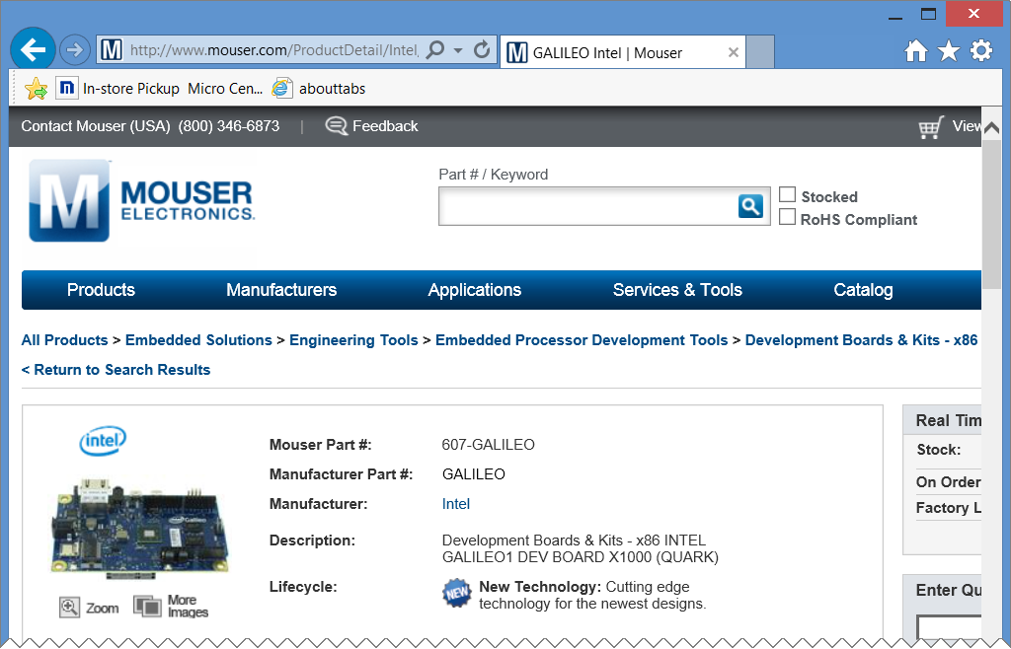

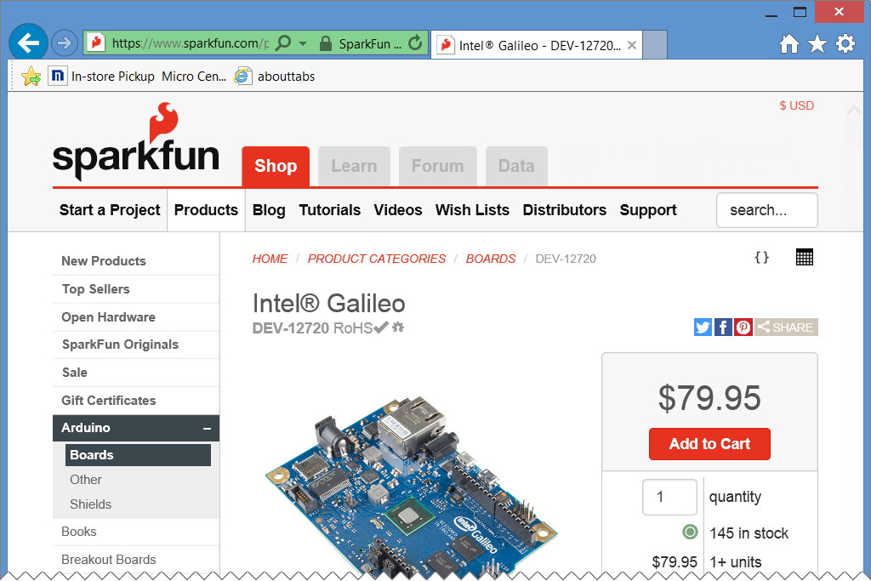
Where can you get one?
Generation 1 (Gen 1) boards now seem to be readily available
Multiple Online sources sell them for around $50-$80 USD…

Slide 6
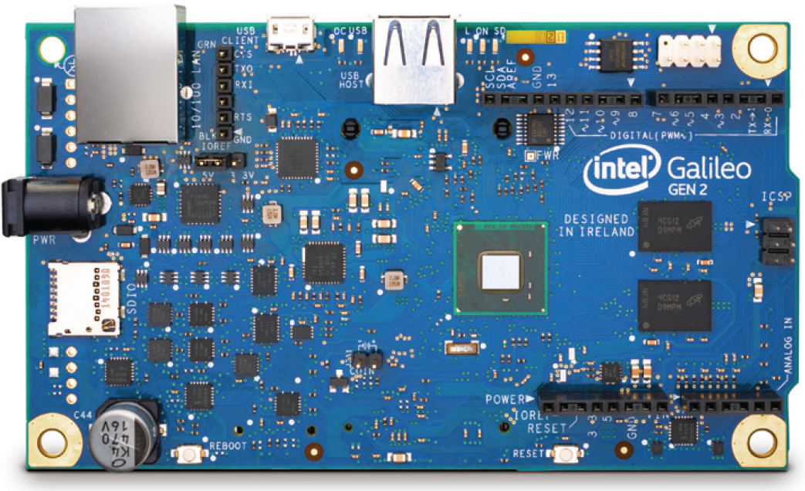
Galileo gen 2 boards (not covered in this session)
RS232 connection is now a 6-pin header replaces vs the 3.5mm jack.
The USB Host connection uses a full size connector
12-bit pulse-width modulation (PWM) precision
Serial input can be redirected to the Arduino to reduce the need for SoftwareSerial
12V Power-over-Ethernet (PoE) capable
Power regulation system changed to accept power supplies from 7V to 15V.

Slide 7

Learn more
https://communities.intel.com/community/makers

Slide 8
First look at the Intel Galileo

Slide 9
Setting up your Galileo

Slide 10
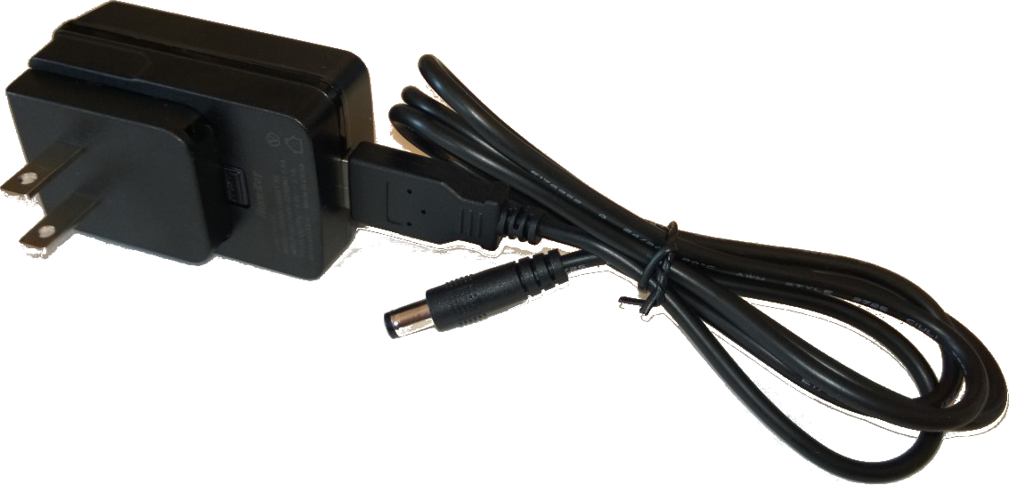
What’s in the box
Intel Galileo
5V Power Supply and Cable

Slide 11
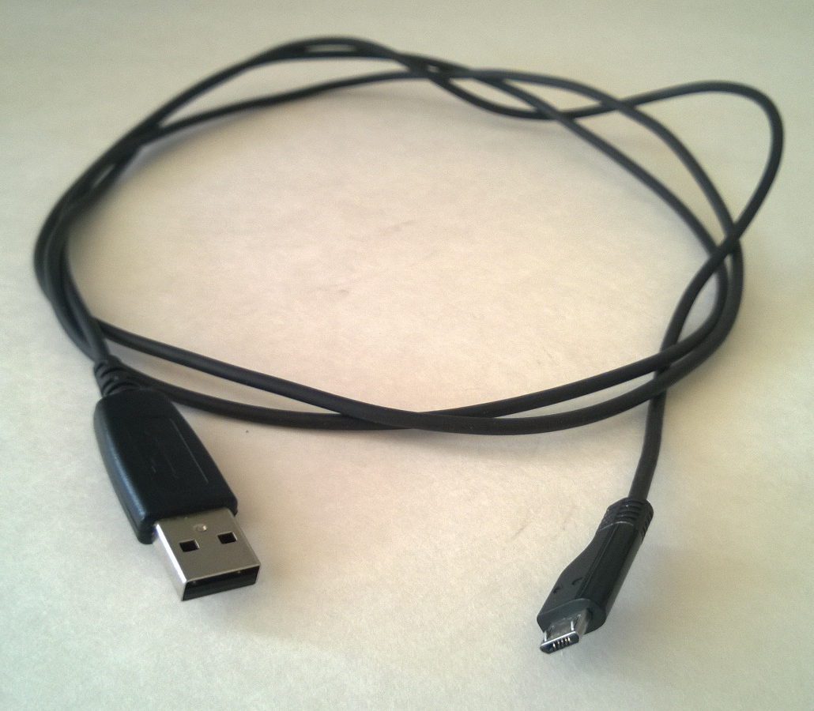
What’s not in the box?
There isn’t a Micro USB cable included in the box. You’ll need to supply one yourself to connect your PC to your Galileo

Slide 12
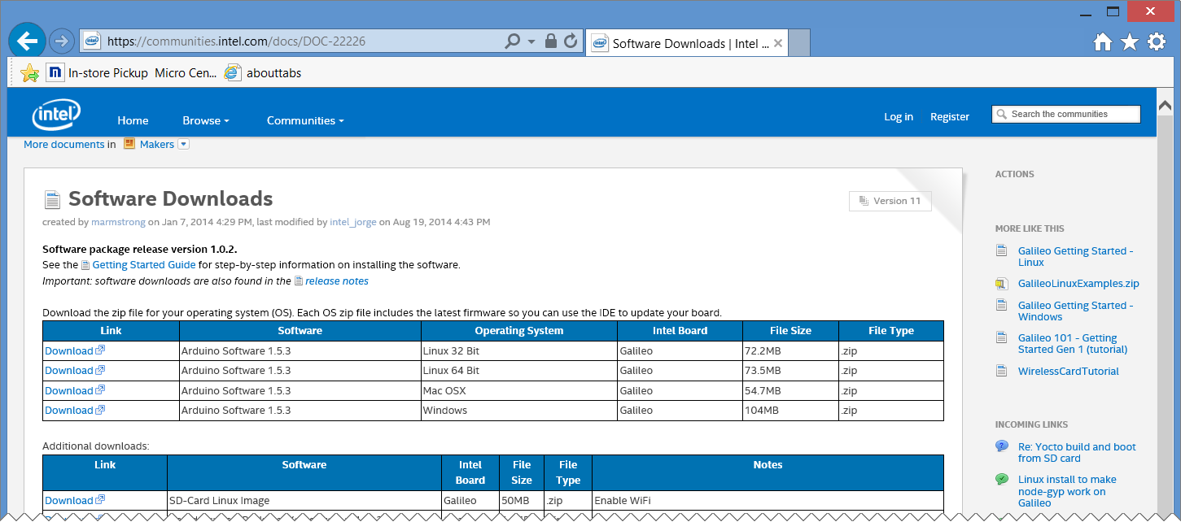
DOWNLOAD the software
https://communities.intel.com/docs/DOC-22226

Slide 13
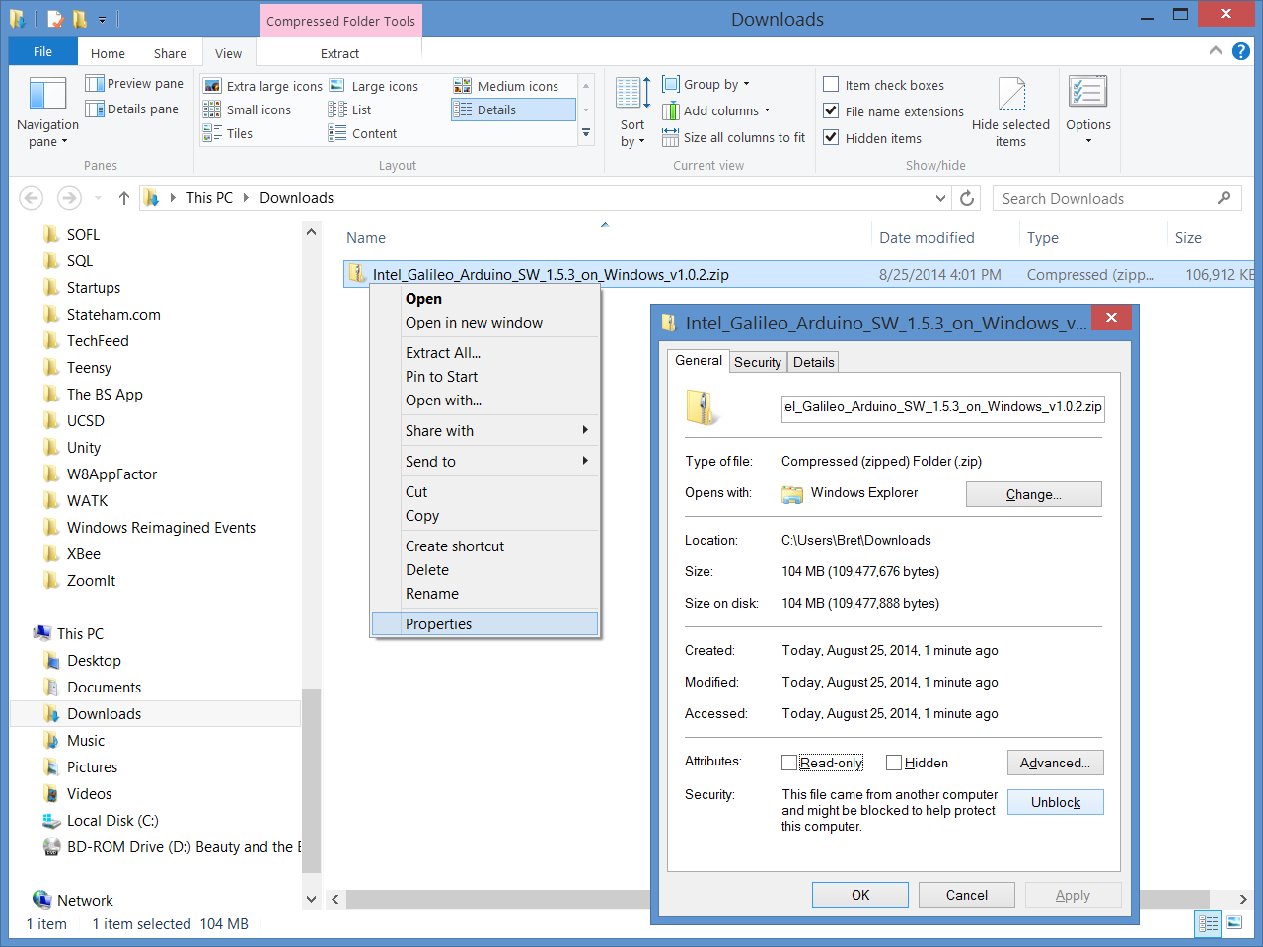
Unblock the .zip file
Windows “Blocks” files downloaded from the Internet.
Before you extract the .zip file, “Unblock” it first to prevent security errors later.

Slide 14
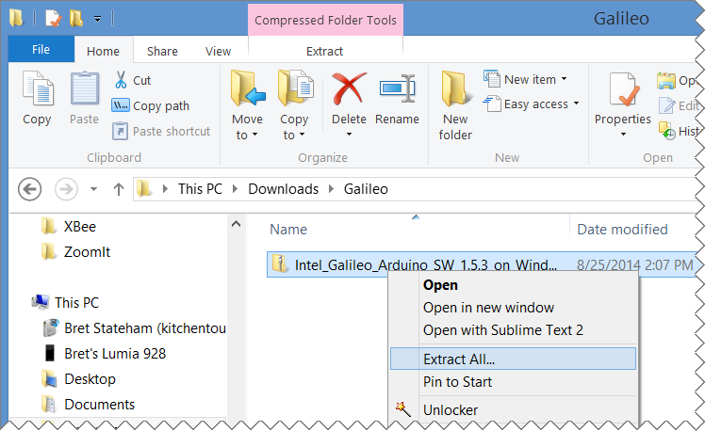
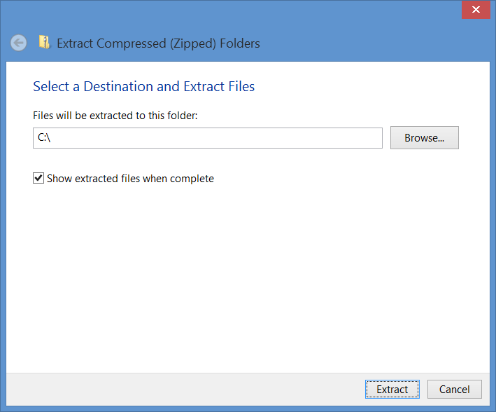
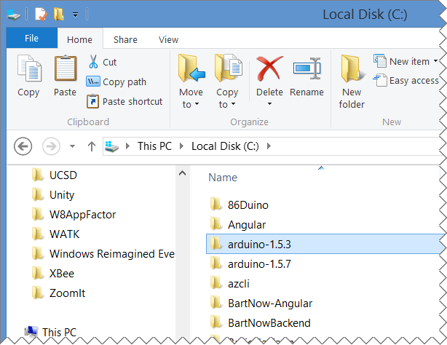
Extract .ZIP TO THE ROOT
If you don’t extract to the root (or to a path close to the root) you could exceed the maximum path length
If you already have a copy of the Arduino IDE installed, make sure to extract this to a different path.
You can have multiple versions of the Arduino IDE on the same machine by simply extracting the .zip to a different location

Slide 15
Connect to power and usb
Make sure to use the 5V power supply that was provided with your Galileo! DO NOT USE MORE THAN 5v!

Slide 16
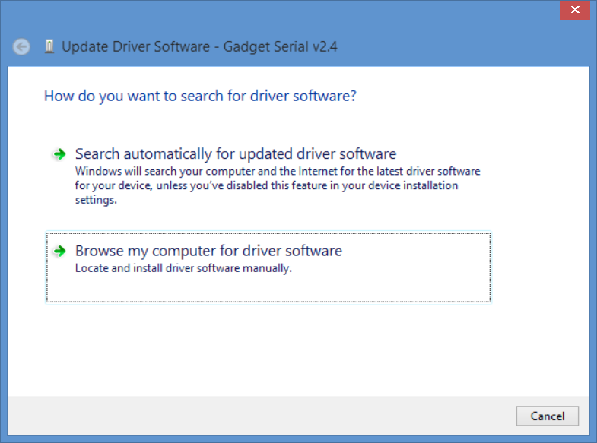
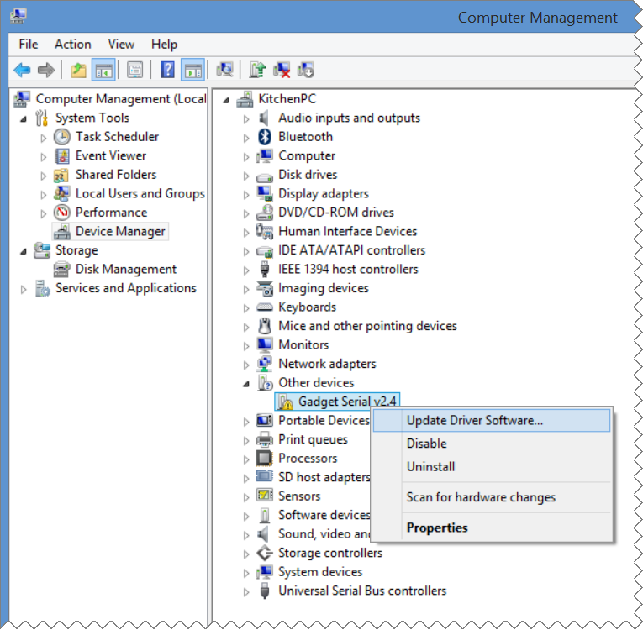
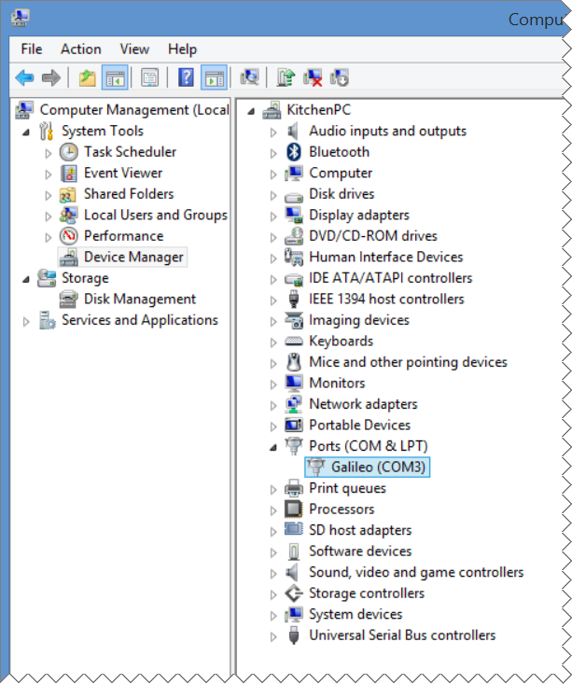
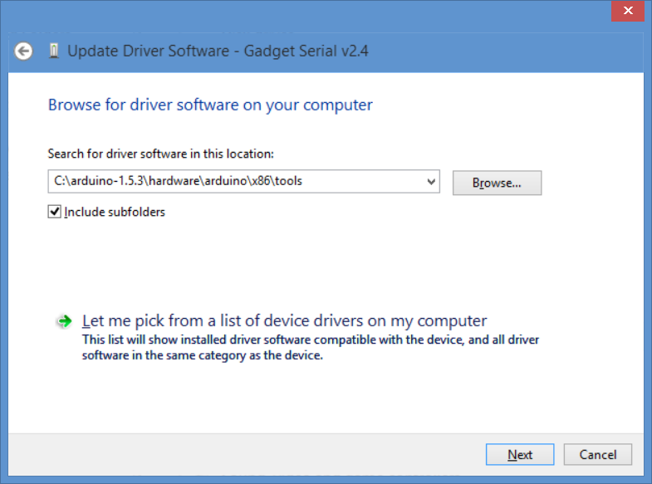

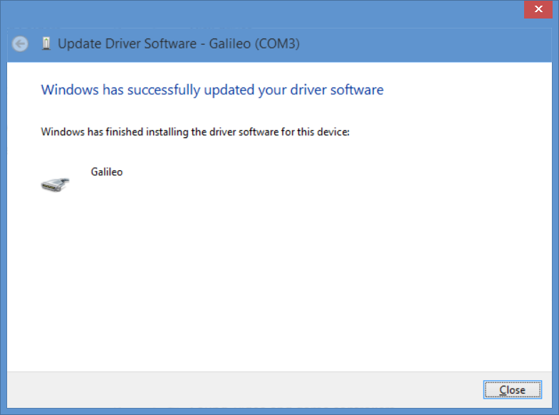
Install the device driver

Slide 17
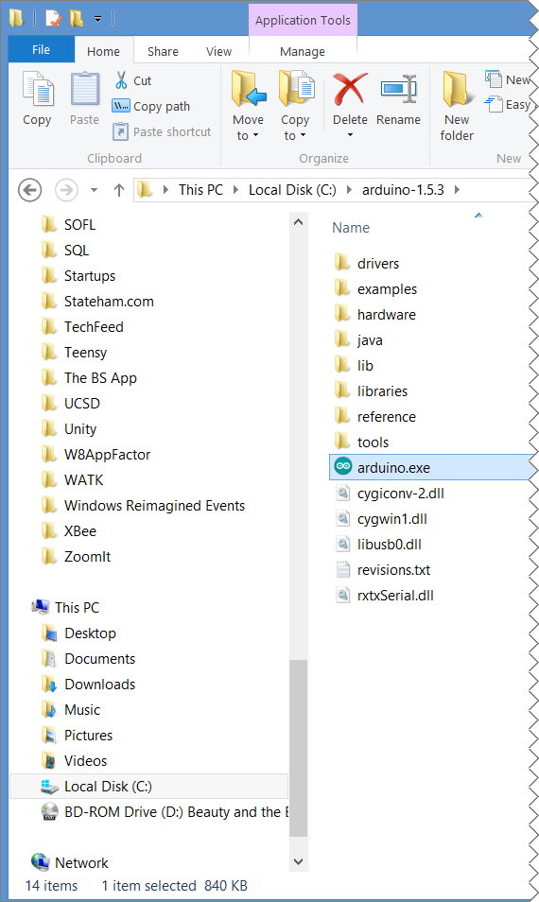
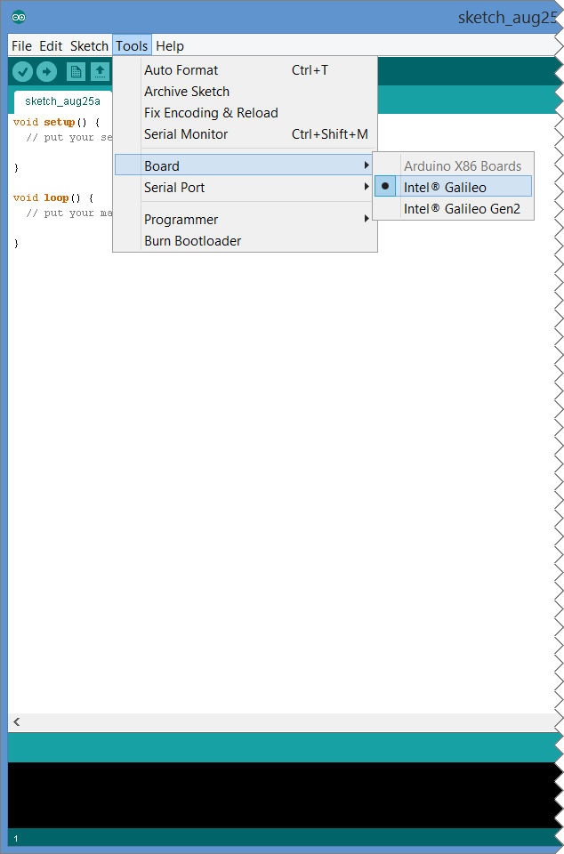
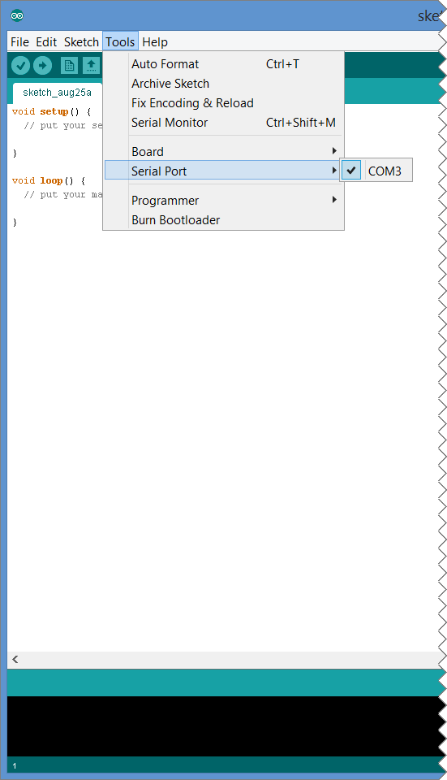
Run the Arduino IDE & SELECT GALILEO

Slide 18
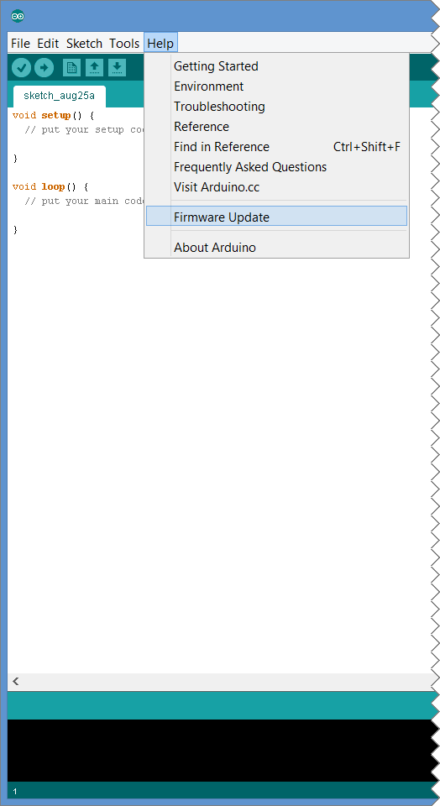
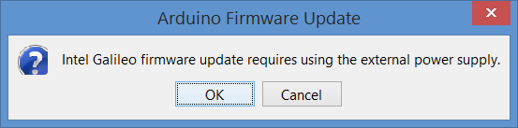
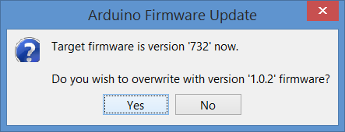
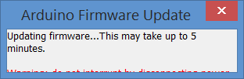
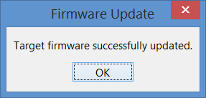
Update the Galileo's firmware

Slide 19
Setting up your Intel Galileo

Slide 20
Running your first sketch

Slide 21


Processing, Wiring, Arduino & Galileo
Processing (processing.org) Was developed to help artists, etc. learn programming and use technology in their creative efforts
Wiring (wiring.org.co) Wiring built on Processing to provide a way to write code for a microcontroller
Arduino (arduino.cc) The Arduino development language and IDE is based on that of Wiring and adds specific functionality for the Arduino board as well as libraries for common hardware
Galileo (maker.intel.com) Is an “Arduino Certified” board based on an Intel processor. It allows you to develop applications using the Arduino IDE and libraries, mostly un-modified.

Slide 22
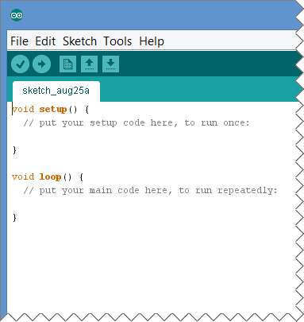
Arduino “sketches”
Arduino programs are called “Sketches”
The “setup” method runs once at the beginning
The “loop” method is called repeatedly
Upload your sketch to the selected board to run your sketch

Slide 23
Digital Pins
Digital Pins 0-13 and Analog pins A0-A5 allow you to read and write digital signals (LOW or HIGH)
Configure a pin for output with: pinMode(pin#,OUTPUT);
Write values with:
digitalWrite(pin#,LOW); or
digitalWrite(pin#,HIGH);
Configure a pin for input with:
pinMode(pin#,INPUT);
Read values from the pin with:
int val = digitalRead(pin#);

Slide 24
POWER
Multiple Ground (GND) and Voltages (3.3v and 5v) can be accessed from the board.
Use these to supply ground and power to other sensors, LEDs, etc.
Make sure not to draw more amperage that the board is rated for. (800mA max across all pins - learn more

Slide 25
Light emitting diodes (LEDs)
Anode (+)
Cathode (-)
Diodes only let current flow in one direction
They have a “polarity” which means you need to connect them the right way.
The side of the LED that is connected to the positive voltage source is called the “Anode”.
The side of the LED that is connected to ground is called the “Cathode”
With Light Emitting Diodes (LEDs), when you apply a positive voltage to the anode, the diode emits light.
Flat Edge
Small Post
Big Post
Long Leg
Short Leg
Vcc (+)
GND

Slide 26

Fritzing.org

Slide 27
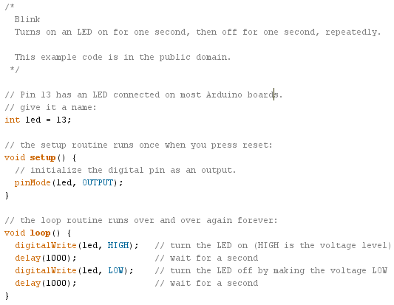
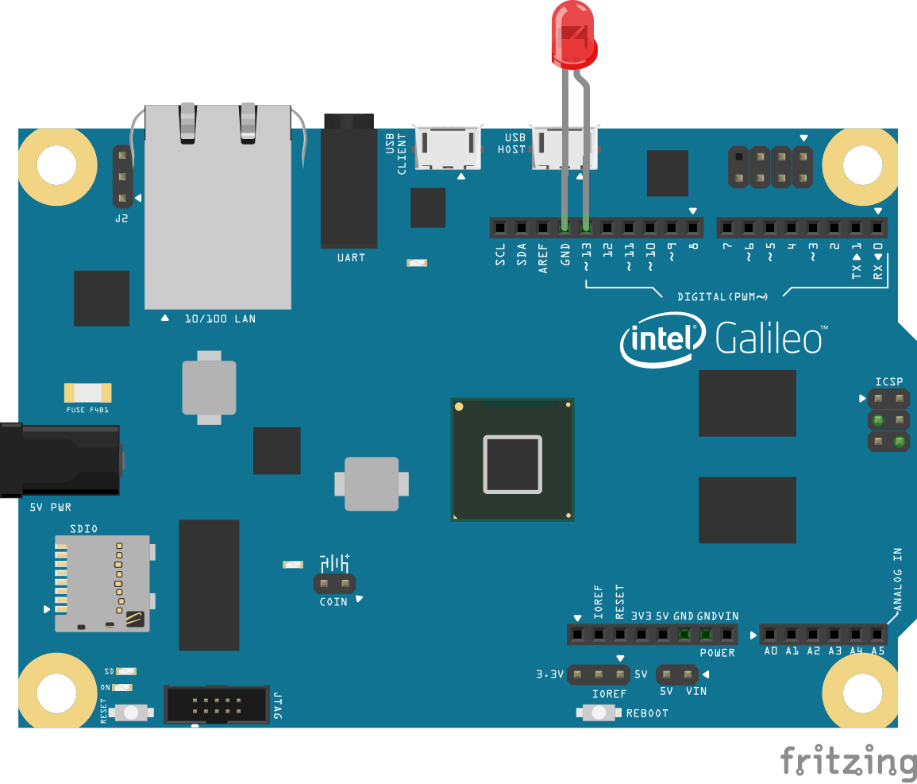
BLINK
Cathode (-) : Short Leg
Anode (+) : Long Leg

Slide 28
Blink – The Arduino “Hello, World!” sketch

Slide 29
Next steps

Slide 30

Get engaged!
maker.intel.com

Slide 31

Run windows on YOUR Galileo
Windows Developer Program for IoT

Slide 32
REVIEW
Intro to the Galileo
Setting up your Galileo
Running your first Sketch
Next Steps

Slide 33
IoT Logo

Slide 34
Arduino

Slide 35
GALILEO BOARD

Slide 36
LEDs

Slide 37
Resistors
220Ω
1st Digit
2nd Digit
Multiplier
Tolerance
Color | Name | 1st Digit | 2nd Digit | Multiplier | Tolerance
 | Black | 0 | 0 | X1
 | Brown | 1 | 1 | X10 | 1%
 | Red | 2 | 2 | X100
 | Orange | 3 | 3 | X1,000
 | Yellow | 4 | 4 | X10,000
 | Green | 5 | 5 | X100,000
 | Blue | 6 | 6 | X1,000,000
 | Violet | 7 | 7
 | Grey | 8 | 8
 | White | 9 | 9
 | Gold |  |  | X0.1 | 5%
 | Silver |  |  | X0.01 | 10%
330Ω
10KΩ

Slide 38
USB

